Slide 1

Sentiment Synthesis based on Vedic Astrology Dissertation I (MCS-392) M.Tech-CSE Nov 9, 2023 Teerthanker Mahaveer University, College of Computing Sciences & Information Technology, Moradabad-244001(India) Session: 2022-23
Guided By: Ms. Sukrati Jain & Mr. Vikas Deswal
Presented By: Mohit Singh

Slide 2
Contents
Introduction
Problem Statement
Literature Review
Hypothesis
Research Methodology
References

Slide 3
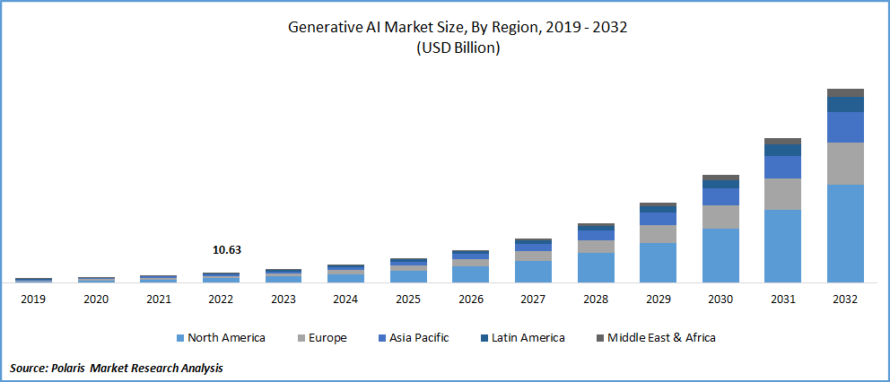
Introduction

Slide 4
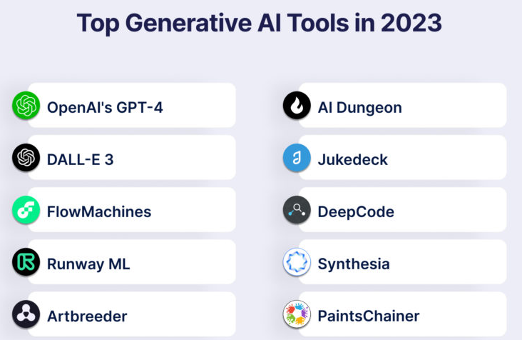
Introduction

Slide 5
Problem Statement
Despite of seeing the huge development in the field of Generative AI, still we can see the need and requirement of more emotionally smart and intelligent systems that can generate thier outputs more creatively and artistically. Designing such kind of a system is a very big challenge for us today and this reseach is all about that.

Slide 6
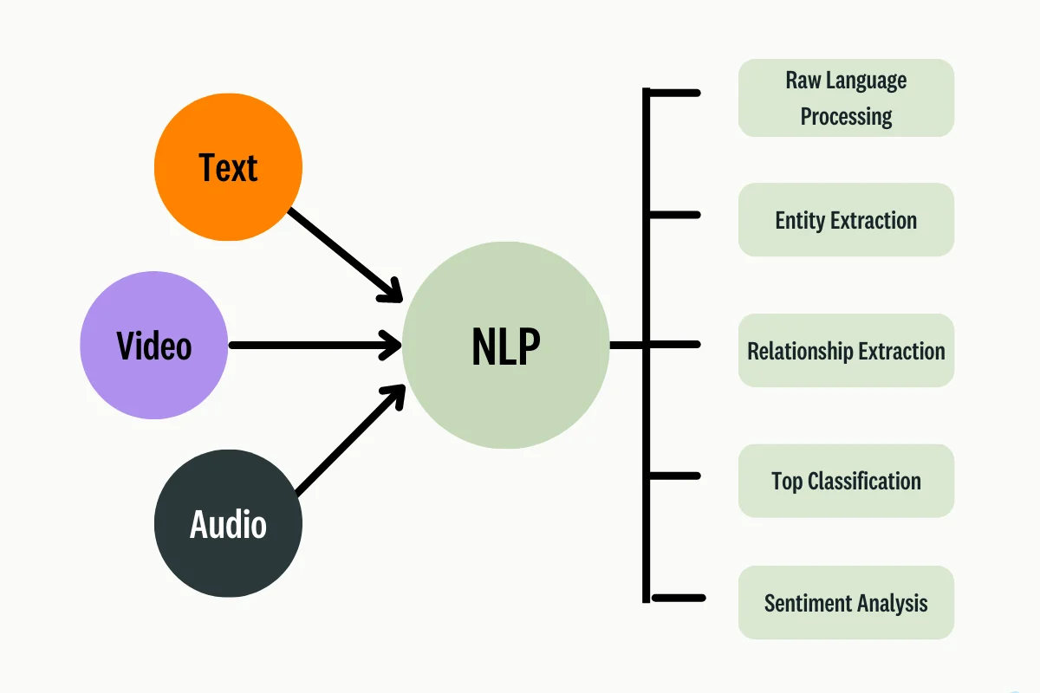
Literature Review
Natural Language Processing(NLP)

Slide 7
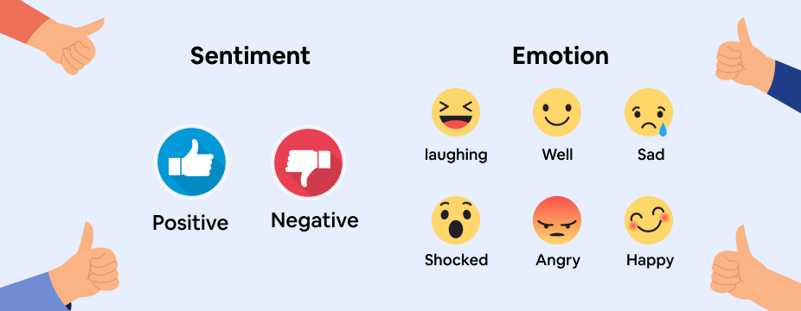
Literature Review
Sentiment Analysis
Data (Text, Audio, Video)
Sentiment Analysis Algorithm

Slide 8
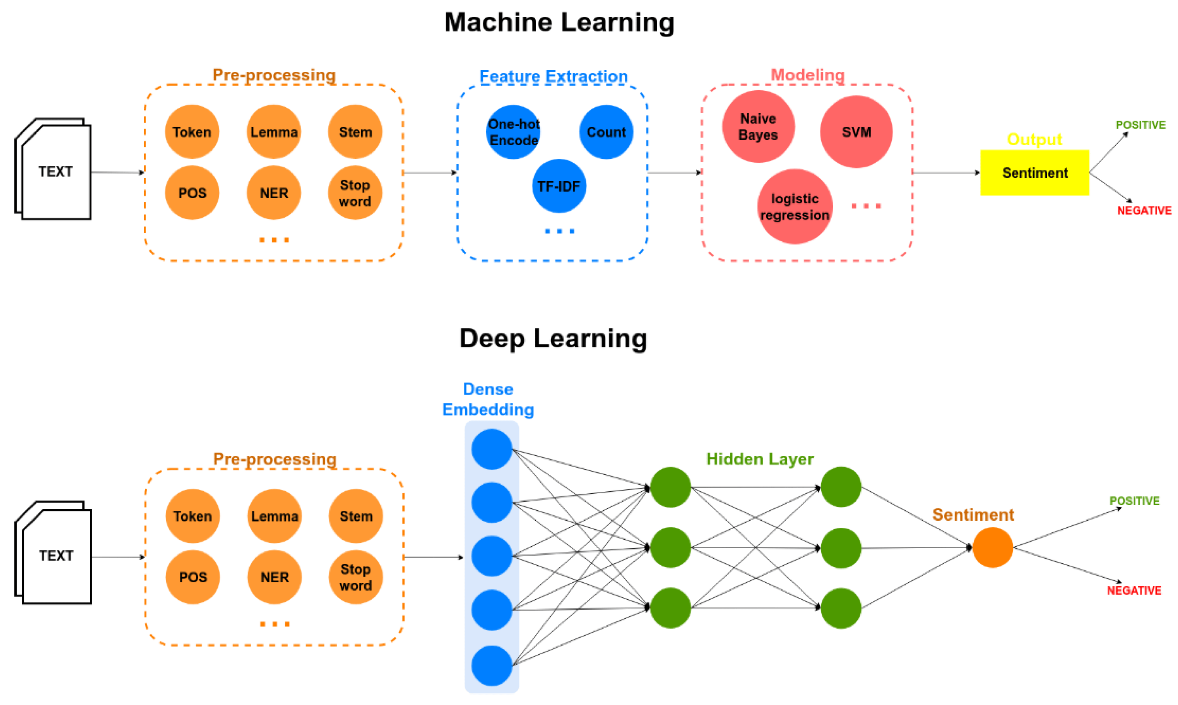
Literature Review
Sentiment Analysis using Machine Learning & Deep Learning

Slide 9
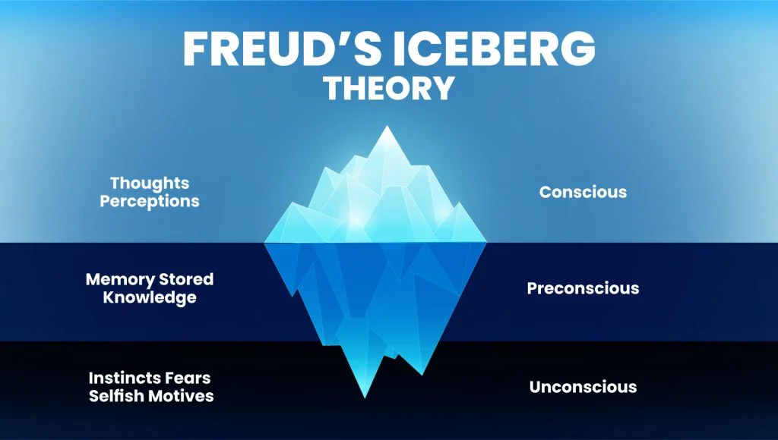
Literature Review
Sigmund Freud’s Iceberg Theory

Slide 10
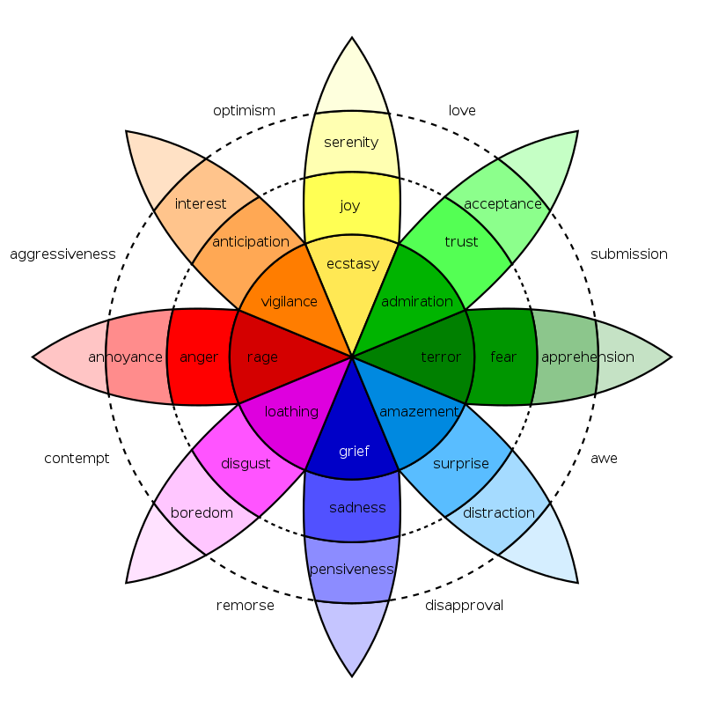
Literature Review
Robert Plutchik’s Wheel of Emotions

Slide 11
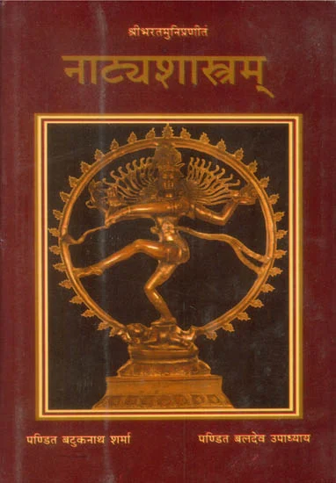
Literature Review
Natya Shastra of Bharata Muni

Slide 12
Literature Review
Bhaav
Rati
Haas
Krodha
Utsaha
Bhaya
Jugupsu(Ghrina)
Vismaya
Shoka
Rasa
Shringar
Hasya
Raudra
Veer
Bhayanaka
Veebhakta
Adbhuta
Karuna

Slide 13
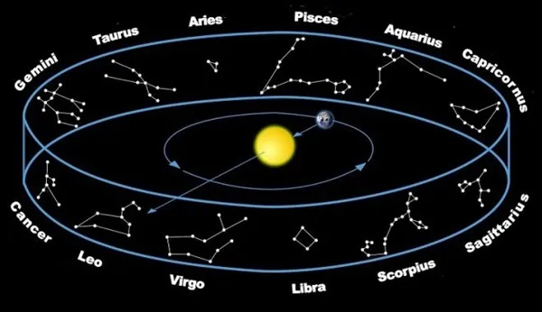
Literature Review
The Zodiac Belt

Slide 14
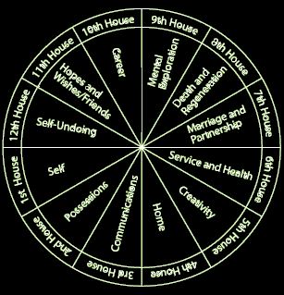
Literature Review
12 Energy Zones (Houses)

Slide 15
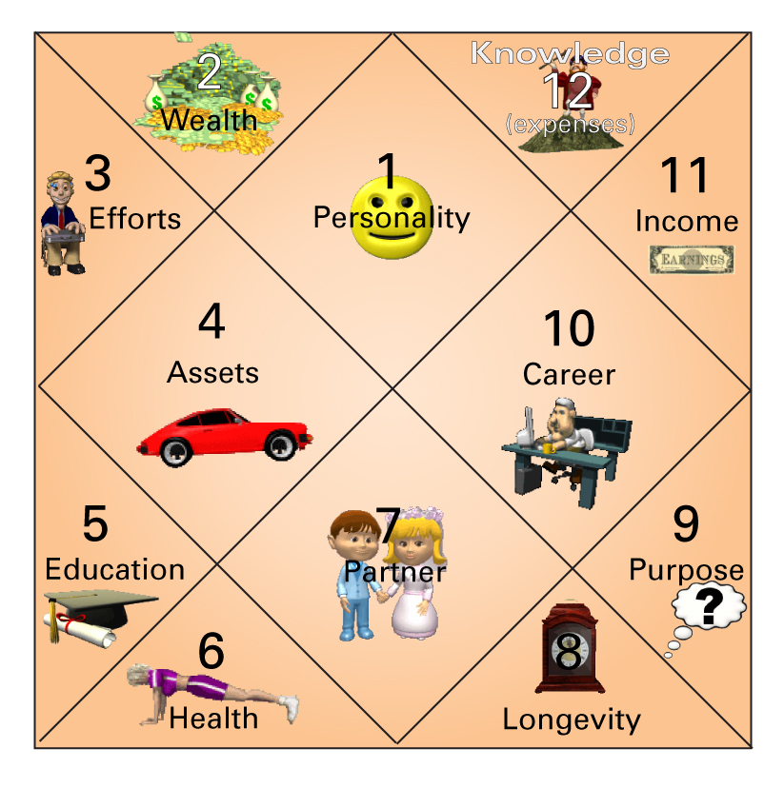
Literature Review
Signification of Houses

Slide 16
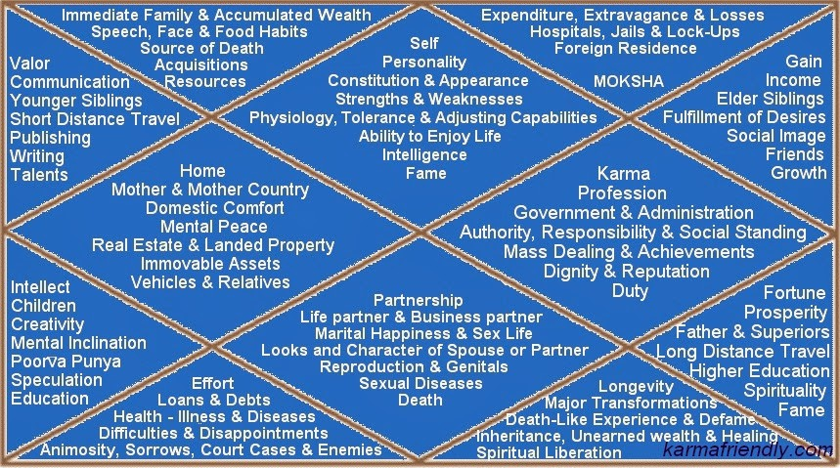
Literature Review
Signification of Houses

Slide 17
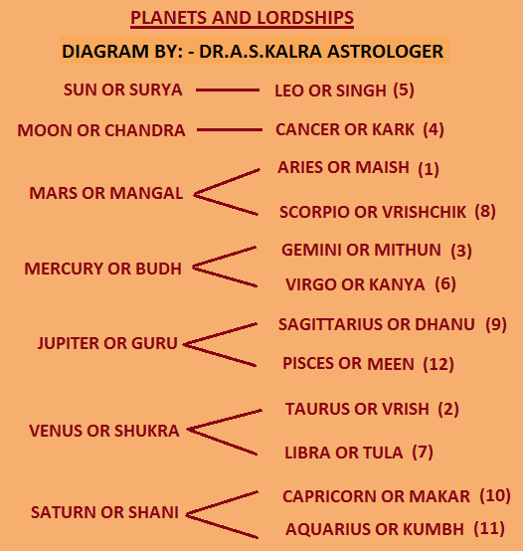
Literature Review
Signification of 12 Signs & 9 Planets

Slide 18
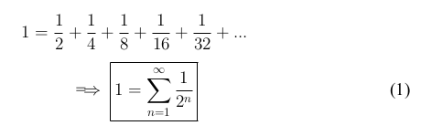
Literature Review
Convergence

Slide 19
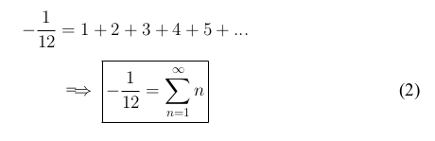
Literature Review
Divergence

Slide 20
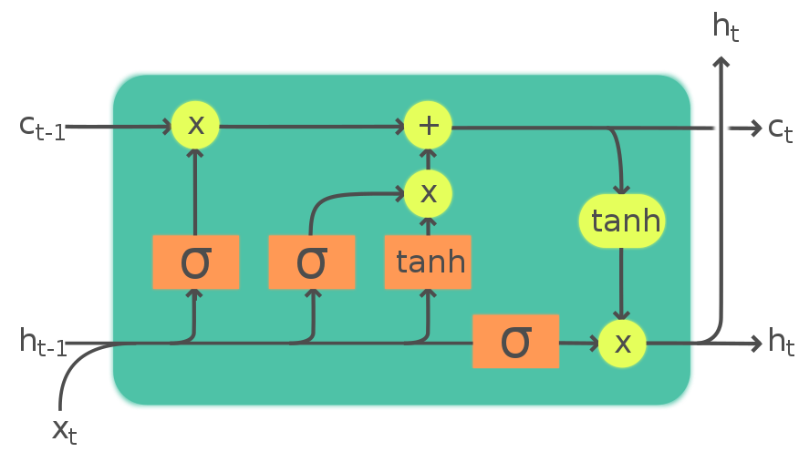
Literature Review
Long Short Term Memory(LSTM)

Slide 21
Hypothesis
Is sentiment synthesis(the generation of artificial intution in machines) based on the parameters of vedic astrology possible?

Slide 22
Research Methodology
Sentiment Synthesis
Vedic Astrology Parameters (Planetry Positions, Degrees, Transits, etc.)
Sentiment Synthesis Algorithm
Data (Text, Audio, Video)

Slide 23
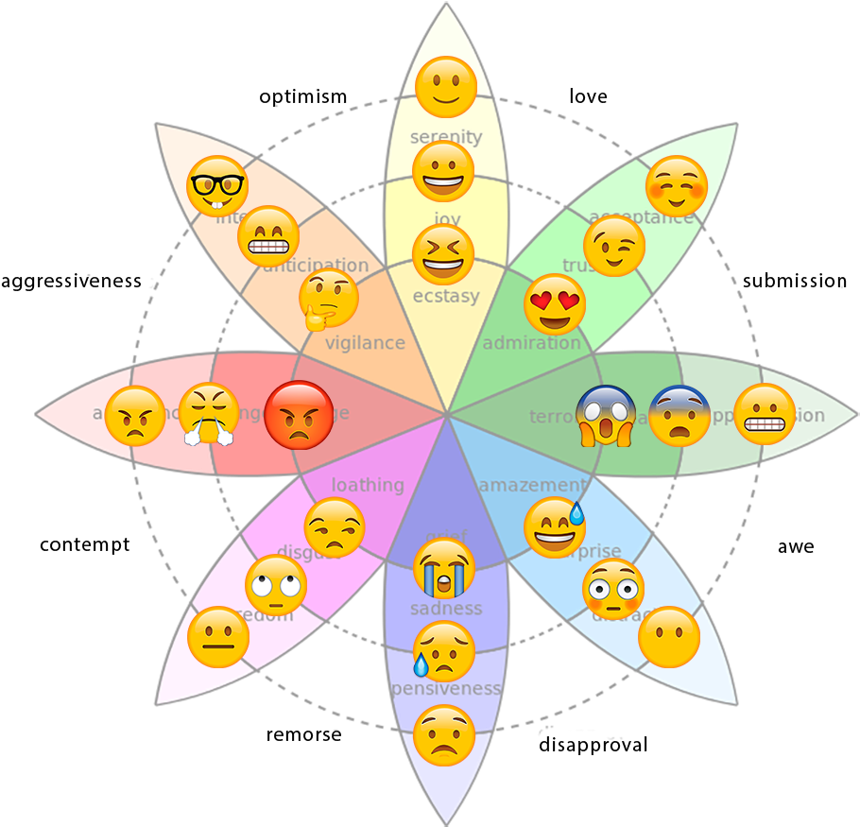
Research Methodology

Slide 24
References
S. V. Sahiti S. Magapu, “The Study of Emotional Intelligence in Artificial Intelligence,” International Journal of Innovative Science and Research Technology (IJISRT), vol. 4, pp. 594–602, 01 2019
M. Abbasi and A. Beltiukov, “Summarizing Emotions from Text Using Plutchik’s Wheel of Emotions,” Atlantis-Press, vol. 166, pp. 291–294, 05 2019
S. Hochreiter and J. Schmidhuber, “Long Short-term Memory,” Neural computation, vol. 9, pp. 1735–80, 12 1997
N. C. Dang, M. N. Moreno-García, and F. De la Prieta, “Sentiment Analysis Based on Deep Learning: A Comparative Study,” Electronics, vol. 9, no. 3, 2020
E. Piletsky, “Consciousness and Unconsciousness of Artificial Intelligence,” Future Human Image, vol. 11, pp. 66–71, 03 2019

Slide 25
References
Natya Shastra of Bharata Muni with Abhinava Bharati I - Madhsusudan Shastri(M.A.)
Surya Siddhanta - Prof. Ram Chandra Pandey
Brihat Parashar Hora Shastra Vol 1 - Dr. Suresh Chandra Mishra
Brihat Parashar Hora Shastra Vol 2 - Dr. Suresh Chandra Mishra
Wikipedia - Sigmund Freud
Wikipedia - Robert Plutchik
Wikipedia - Geometric Series
Wikipedia - Ramanujan Summation

